Slide 1
MINI-PROJECT REVIEW I
NOTE TAKING AND TO-DO LIST APP
13-08-2025
WEDNESDAY
VIGNESHVARAN A
24PCA528

Slide 2
Introduction
The Attendance Management System is a web-based application designed to enable users to view and manage the attendance of the students. Unlike traditional systems that require manual data entry and record-keeping, the proposed system automates these processes by leveraging a database management system that maintains relationships between tables and handles data efficiently.
This project responds to the growing demand for a streamlined and user-friendly platform tailored to meet modernise college attendance systems. It explores how technology can be integrated with basis to enhance customer experience, improve accessibility, and optimize operational efficiency.

Slide 3
Introduction
The system is developed using html for the frontend, Express.js for the backend, and MongoDB as the database. It is structured into three main modules:
❖ Staff
❖ Admin
❖ Student

Slide 4
System Study
Existing System
Manual record-keeping increases the chances of errors
Risk of data loss due to damaged or misplaced records
Time-consuming processes that slow down daily operations
Need for physical presence to mark or verify attendance
Difficulty in generating accurate reports and maintaining long-term data records

Slide 5
System Study
Proposed System
Unified Platform: Manage student, staff, and course attendance records in one system.
Real-Time Updates: Instantly record and update attendance data without delays.
Robust Data Management: MongoDB database with efficient CRUD operations and secure data handling.
User-Friendly Design: Clean, responsive UI for smooth navigation across devices.
Role-Based Access: Separate modules and permissions for admin, staff, and students.

Slide 6
System Study
Problem Definition & Project Description
Tracking and managing student attendance is a critical task for educational institutions, but traditional methods often create inefficiencies and inaccuracies.
Traditional methods (paper or unstructured digital notes) are:
Prone to human errors and misplacement of records
Time-consuming to update and maintain
Difficult to search and retrieve specific data
Lacking in real-time access and report generation features

Slide 7
System Study
Problem Definition & Project Description
Many existing apps:
Are overly complex
Require constant internet access
Lack integration between notes and checklists
Need for a lightweight, offline, user-friendly app to manage both personal and professional tasks efficiently.

Slide 8
System Analysis
System Requirements
Many existing apps:
Are overly complex
Require constant internet access
Lack integration between notes and checklists
Need for a lightweight, offline, user-friendly app to manage both personal and professional tasks efficiently.

Slide 9
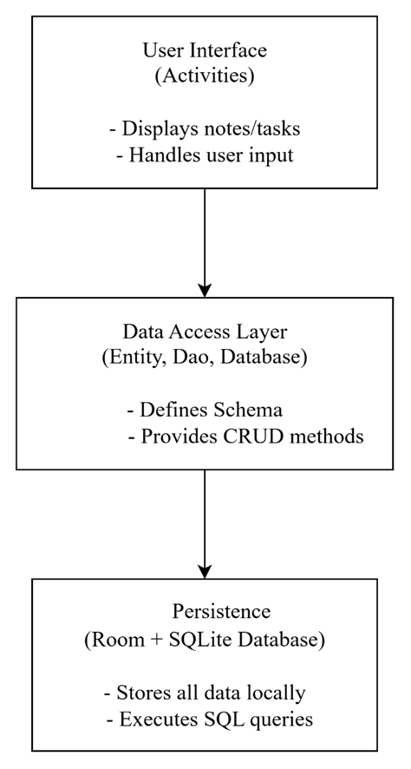

System Design
Architectural Design

Slide 10
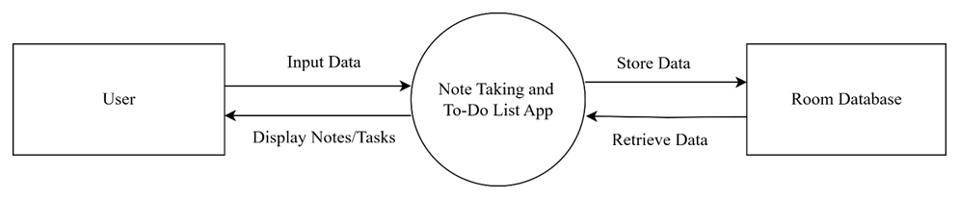
System Design
Data Flow Diagram
DFD Level 0

Slide 11
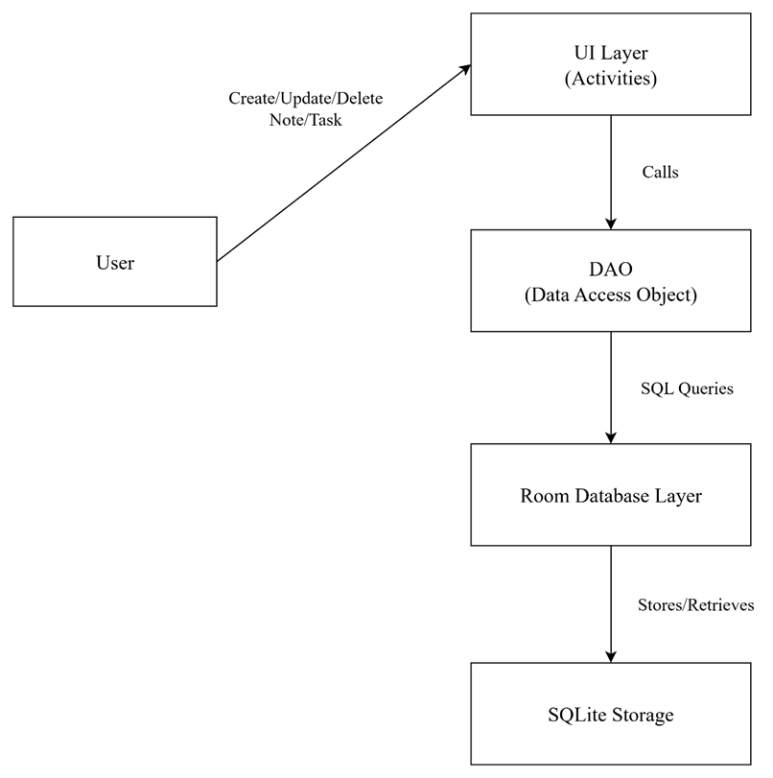
System Design
Data Flow Diagram
DFD Level 1

Slide 12
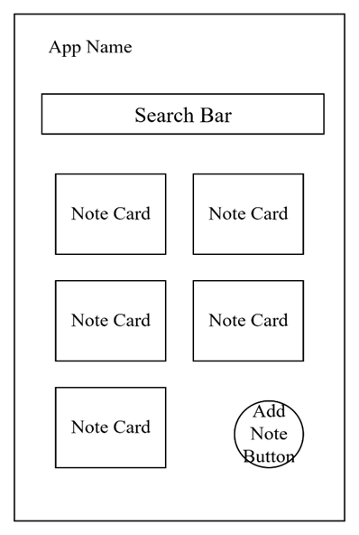
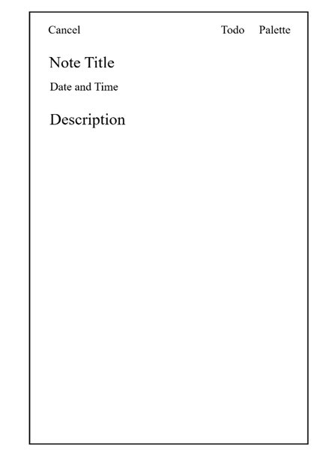
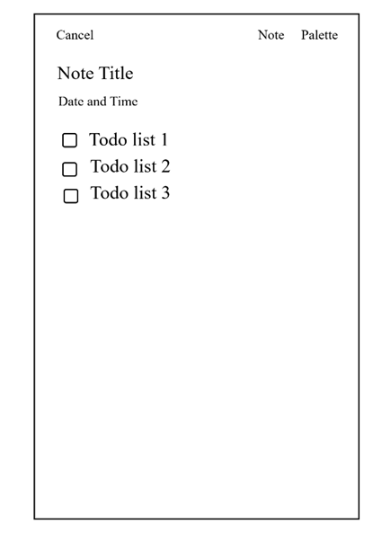
User Interface Design
Home Page
Note Creation Page
Todo List Mode

Slide 13
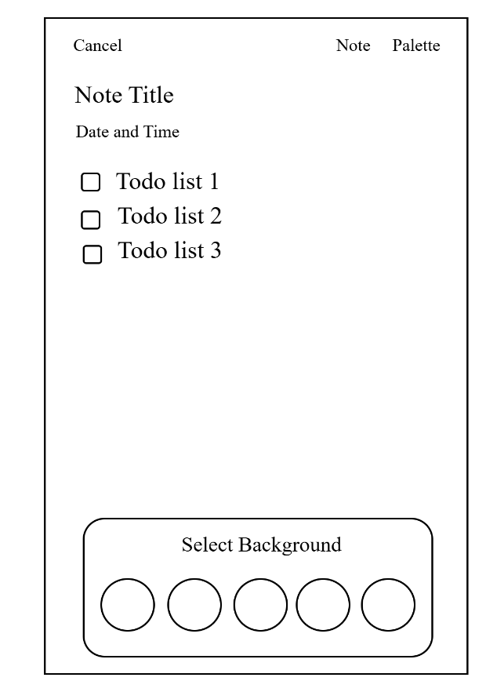
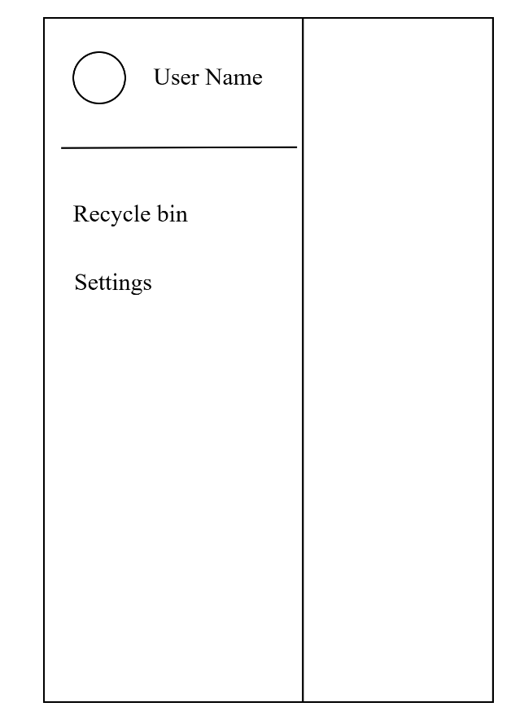
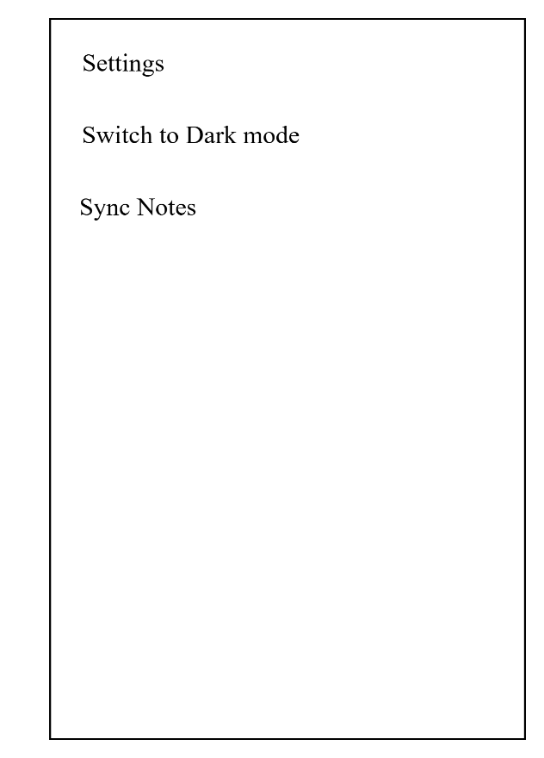
User Interface Design
Choose Color
Side Bar
Settings

Slide 14
Normalization
Normalization is the process of organizing the data in the database.
Normalization is used to minimize the redundancy from a relation or set of relations.

Slide 15
THANK YOU

